Slide 1
Relative risk and odds ratio
Exercise example from the “Seeing Through Statistics” book

Slide 2
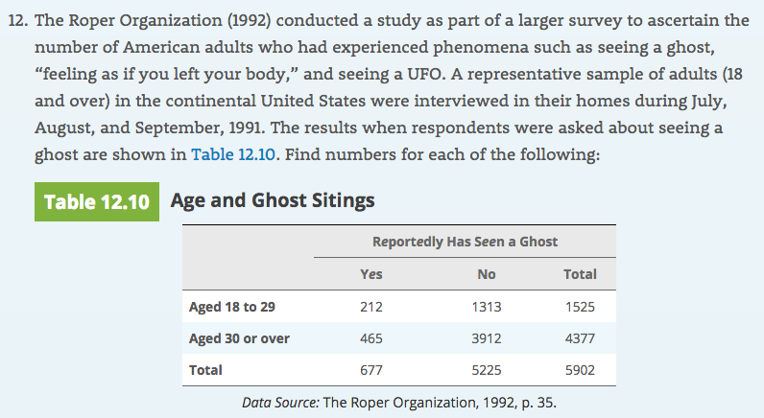
The percentage of the younger group who reported seeing a ghost:

Slide 3
That’s the row corresponding to the younger group: 212 out of 1525 reported yes → 212/1525 = 0.139 x 100 = 13.9%

Slide 4
The proportion of the older group who reported seeing a ghost:

Slide 5
That’s the row corresponding to the older group: 465 out of 4377 reported yes → 465/4377 = 0.106

Slide 6
a. The risk of reportedly seeing a ghost in the younger group:
→ 212/1525 = 0.139

Slide 7
What is the relative risk of reportedly seeing a ghost for
the younger group compared to the older group?
→ Risk for younger 212/1525 = 0.139
→ Risk for older 465/4377 = 0.106
→ Relative risk = Risk younger / Risk older = 0.139 ÷ 0.106 = 1.31

Slide 8
What is the relative risk of reportedly seeing a ghost for
the younger group compared to the older group?
→ Relative risk = Risk younger / Risk older = 0.139 ÷ 0.106 = 1.31
We would say: People aged 18 to 29 are 1.31 times as likely to report seeing a ghost as those over 30

Slide 9
What is the odds of reportedly seeing a ghost to not seeing one in the younger group?

Slide 10
What is the odds of reportedly seeing a ghost to not seeing one in the younger group?
Odds = 212 to 1313 = 212/1313 = 0.16

Slide 11
What is the odds ratio of reportedly seeing a ghost to not seeing one in the younger group compared to the older group?

Slide 12
What is the odds ratio of reportedly seeing a ghost to not seeing one in the younger group compared to the older group?
Odds ratio = (212/1313) ÷ (465/3912) = 1.36
Odds of seeing a ghost were 1.36 higher for the younger group.

Slide 13
